Slide 1


Consider two “Cells”
Left
Right
$\frac{dΦ}{dt}=βΦ−ωΨ−Φ(Φ^{2}+Ψ^{2})$
$\frac{dΨ}{dt}=ωΦ+βΨ−Ψ(Φ^{2}+Ψ^{2})$
$\frac{dΦ}{dt}=βΦ−ωΨ−Φ(Φ^{2}+Ψ^{2})$
$\frac{dΨ}{dt}=ωΦ+βΨ−Ψ(Φ^{2}+Ψ^{2})$
Same discrete equations. However, different Beta values
No Penetration, No change in Period Beta=0.5 is bifurcation

Slide 2
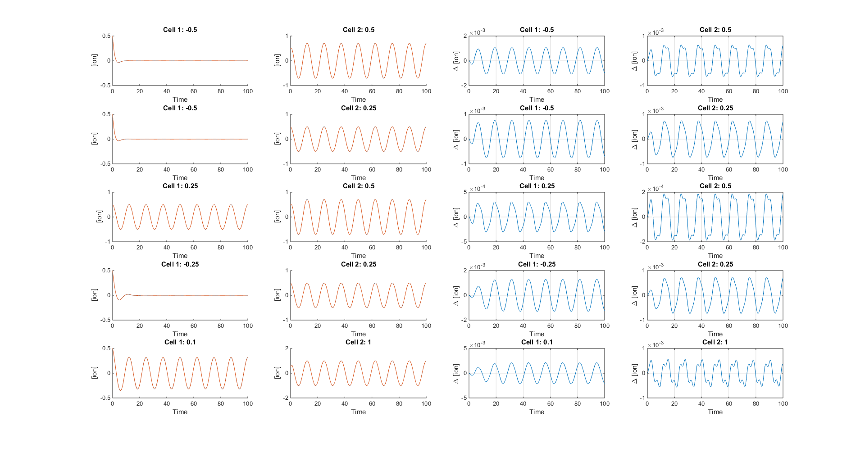
No Interaction
Left
Beta = 0.25
Right
Beta = 0.75

Slide 3


Diffusion Interaction
Left
Beta = 0.25
Right
Beta = 0.75
$$dx(C\left(Cell1\right) − C\left(Cell2\right))$$
$dx$($C\left(Cell2\right) − C\left(Cell1\right)$)

Slide 4
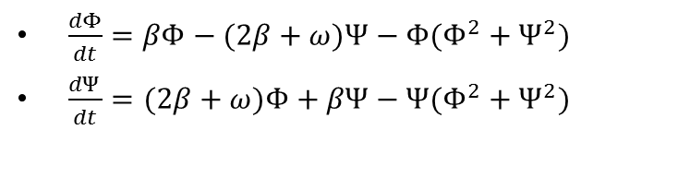
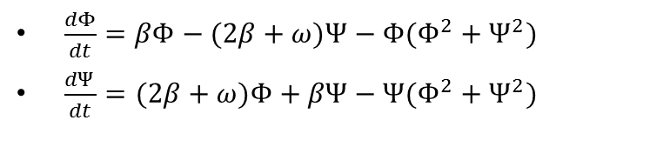
Consider two “Cells”
Left
Right
$\frac{dΦ}{dt}=βΦ−(2β+ω)Ψ−Φ(Φ^{2}+Ψ^{2})$
$\frac{dΨ}{dt}=(2β+ω)Φ+βΨ−Ψ(Φ^{2}+Ψ^{2})$
$\frac{dΦ}{dt}=βΦ−(2β+ω)Ψ−Φ(Φ^{2}+Ψ^{2})$
$\frac{dΨ}{dt}=(2β+ω)Φ+βΨ−Ψ(Φ^{2}+Ψ^{2})$
Same discrete equations. However, different Beta values

Slide 5
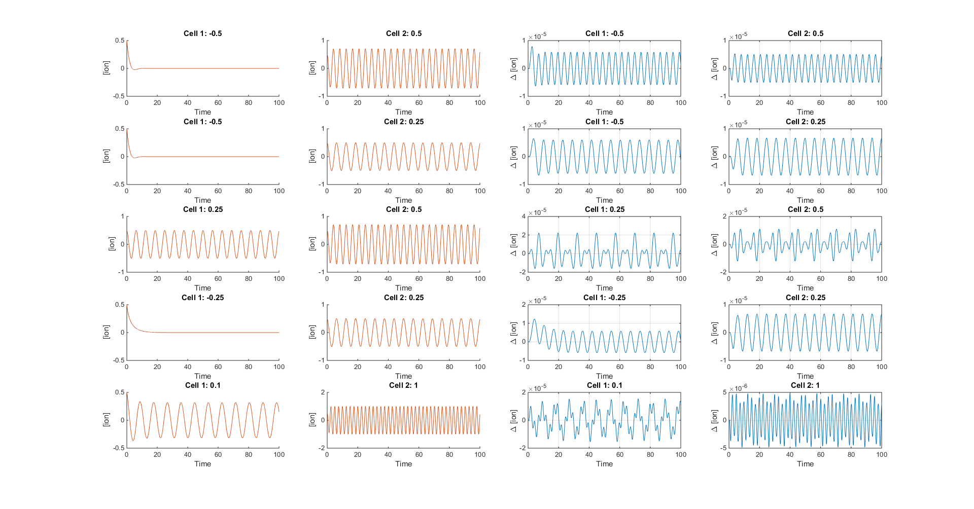
No Interaction
Left
Beta = 0.25
Right
Beta = 0.75

Slide 6
Diffusion Interaction
Left
Beta = 0.25
Right
Beta = 0.75
$$dx(C\left(Cell1\right) − C\left(Cell2\right))$$
$dx$($C\left(Cell2\right) − C\left(Cell1\right)$)

Slide 7
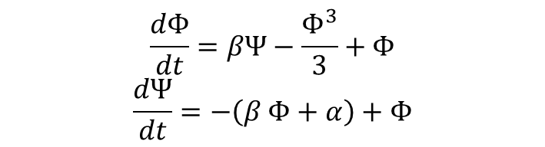
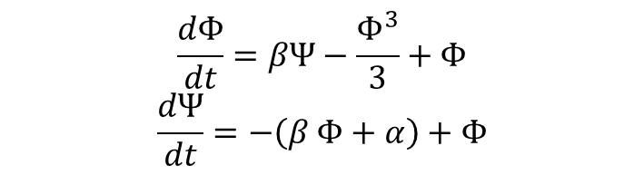
Consider two “Cells”
Left
Right
$$\frac{dΦ}{dt}=βΨ−\frac{Φ^{3}}{3}+Φ$$
$$\frac{dΨ}{dt}=−\left(β Φ+α\right)+Φ$$
$$\frac{dΦ}{dt}=βΨ−\frac{Φ^{3}}{3}+Φ$$
$$\frac{dΨ}{dt}=−\left(β Φ+α\right)+Φ$$
Same discrete equations. However, different Beta values

Slide 8
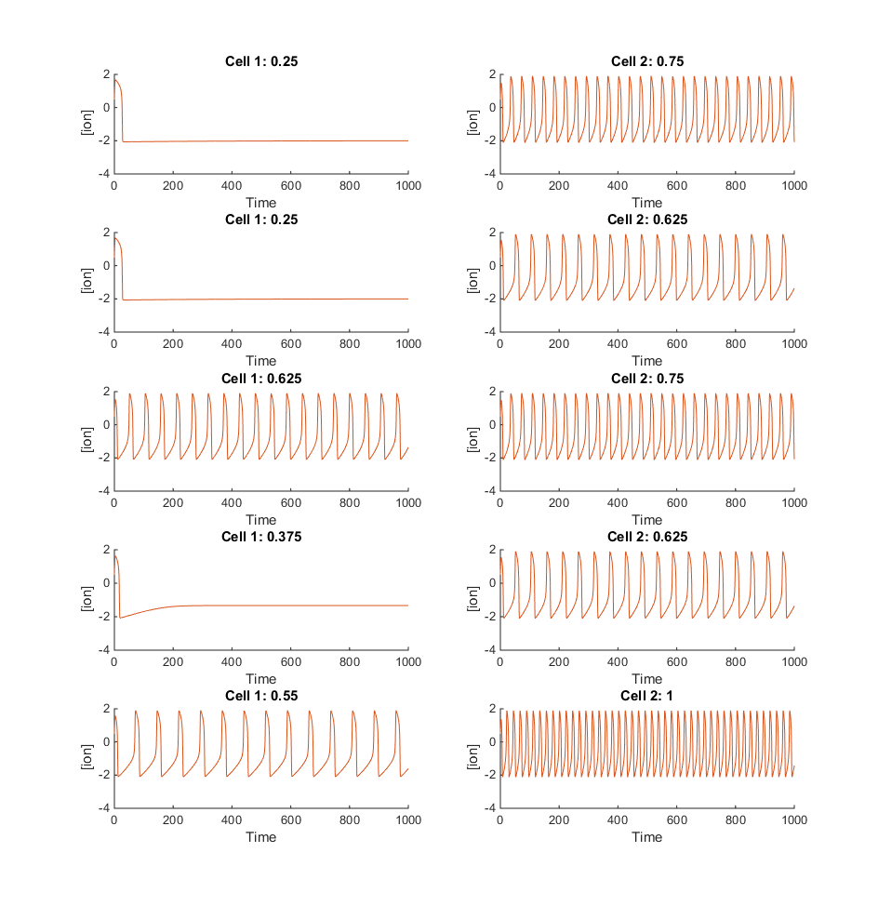
No Interaction
Left
Beta = 0.25
Right
Beta = 0.75

Slide 9
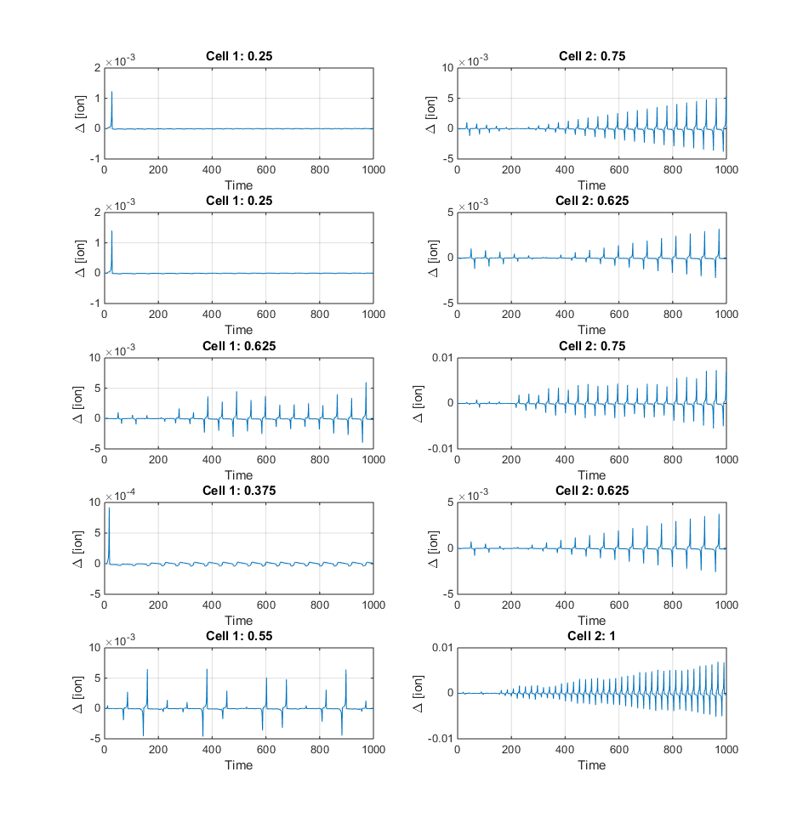
Diffusion = 1e-6
Left
Beta = 0.25
Right
Beta = 0.75

Slide 10
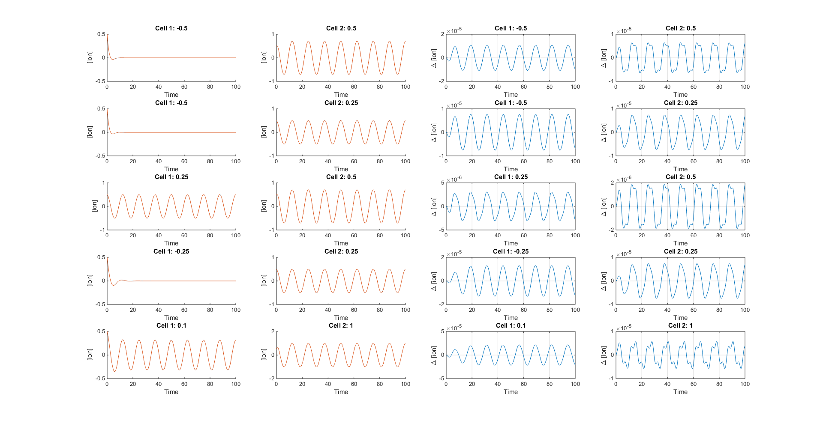
All
D=1e-6

Slide 11

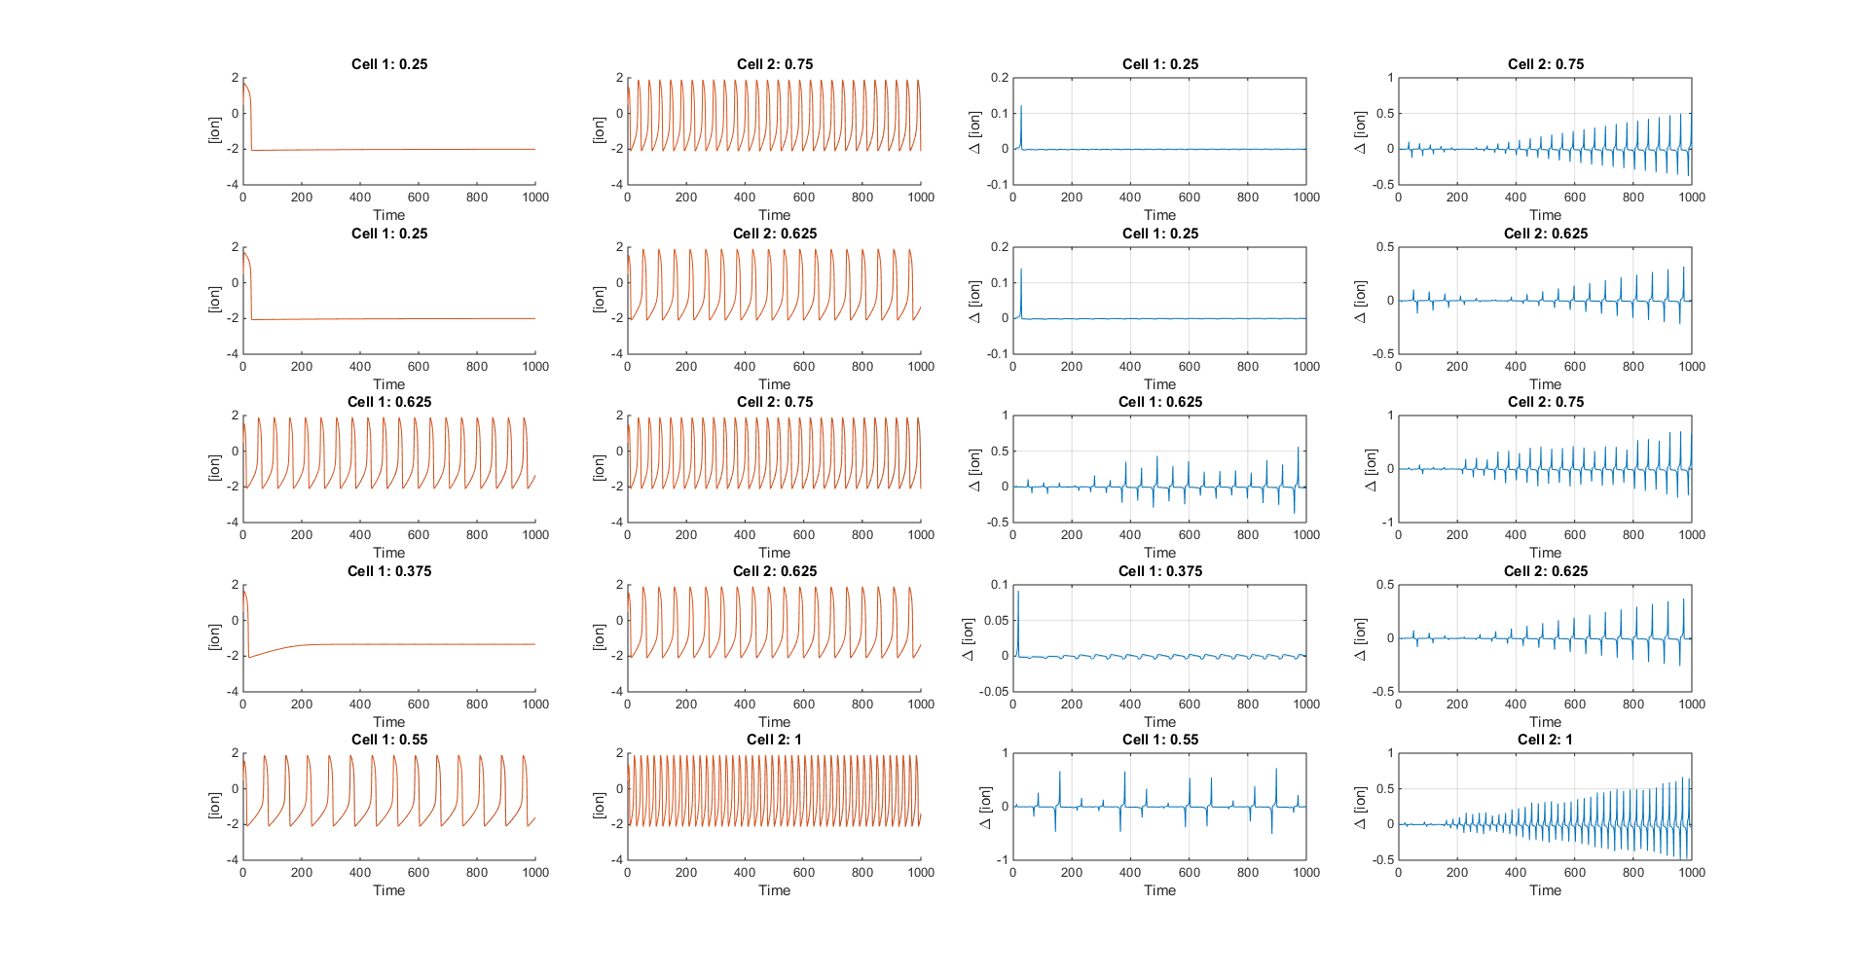
All
D=1e-6*100
All
D=1e-6

